Slide 1
수학 복습

Slide 2
Scale
Rotation
Translation

Slide 3




벡터와 행렬
M = $\left[\begin{matrix}\begin{matrix}m_{11} & m_{12} \\ m_{21} & m_{22}\end{matrix} & \begin{matrix}m_{13} & m_{14} \\ m_{23} & m_{24}\end{matrix} \\ \begin{matrix}m_{31} & m_{32} \\ m_{41} & m_{42}\end{matrix} & \begin{matrix}m_{33} & m_{34} \\ m_{43} & m_{44}\end{matrix}\end{matrix}\right]$
$$\vec{v}=\left[\begin{matrix}\begin{matrix}x & y & z\end{matrix} & 1\end{matrix}\right]$$
$X= xm_{11}+ym_{21}+zm_{31}$+ $m_{41}$
$$Y= xm_{12}+ym_{22}+zm_{32}\text{+} m_{42}$$
$Z= xm_{13}+ym_{23}+zm_{33}$+ $m_{43}$

Slide 4
scale
$$X=ax$$
$$Y=by$$
$$Z=cz$$
M = $\left[\begin{matrix}\begin{matrix}a & 0 \\ 0 & b\end{matrix} & \begin{matrix}0 & 0 \\ 0 & 0\end{matrix} \\ \begin{matrix}0 & 0 \\ 0 & 0\end{matrix} & \begin{matrix}c & 0 \\ 0 & 1\end{matrix}\end{matrix}\right]$
Scale
$$\vec{v}=\left[\begin{matrix}\begin{matrix}x & y & z\end{matrix} & 1\end{matrix}\right]$$
$$\vec{V}=\left[\begin{matrix}\begin{matrix}X & Y & Z\end{matrix} & 1\end{matrix}\right]$$

Slide 5
rotation
$$X=x\cos{β}−y\sin{β}$$
$$Y=x\sin{β}+y\cos{β}$$
$$Z=z$$
M = $\left[\begin{matrix}\begin{matrix}c & −s \\ s & c\end{matrix} & \begin{matrix}0 & 0 \\ 0 & 0\end{matrix} \\ \begin{matrix}0 & 0 \\ 0 & 0\end{matrix} & \begin{matrix}1 & 0 \\ 0 & 1\end{matrix}\end{matrix}\right]$
Rotation Z
$$\vec{v}=\left[\begin{matrix}\begin{matrix}x & y & z\end{matrix} & 1\end{matrix}\right]$$
$$\vec{V}=\left[\begin{matrix}\begin{matrix}X & Y & Z\end{matrix} & 1\end{matrix}\right]$$

Slide 6
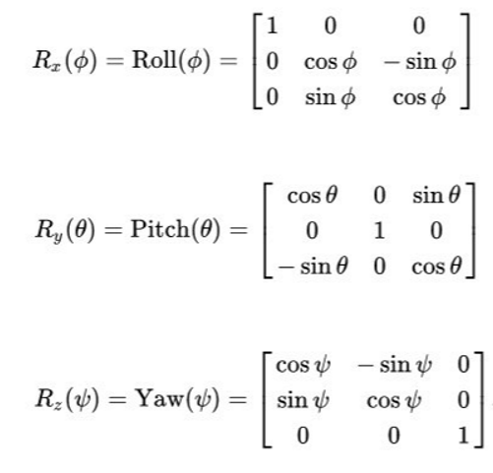
rotation
Rotation

Slide 7
Translation
$$X=x+a$$
$$Y=y+b$$
$$Z=z+c$$
M = $\left[\begin{matrix}\begin{matrix}1 & 0 \\ 0 & 1\end{matrix} & \begin{matrix}0 & 0 \\ 0 & 0\end{matrix} \\ \begin{matrix}0 & 0 \\ a & b\end{matrix} & \begin{matrix}1 & 0 \\ c & 1\end{matrix}\end{matrix}\right]$
Translation
$$\vec{v}=\left[\begin{matrix}\begin{matrix}x & y & z\end{matrix} & 1\end{matrix}\right]$$
$$\vec{V}=\left[\begin{matrix}\begin{matrix}X & Y & Z\end{matrix} & 1\end{matrix}\right]$$

Slide 8
Scale
Rotation
Translation
Rotation
Parent
스 자 이 공 부

Slide 9
좌표계 변환
$$\vec{V}$$
$$\vec{U}$$
$$B$$
$$\vec{v}$$
$$A$$
$$\vec{u}$$
(B 좌표계 기준) $\vec{u}$, $\vec{v}$, $\vec{w}의$ 성분
M = $\left[\begin{matrix}\begin{matrix}u_{x} & u_{y} \\ v_{x} & v_{y}\end{matrix} & \begin{matrix}u_{z} & 0 \\ v_{z} & 0\end{matrix} \\ \begin{matrix}w_{x} & w_{y} \\ Q_{x} & Q_{y}\end{matrix} & \begin{matrix}w_{z} & 0 \\ Q_{z} & 1\end{matrix}\end{matrix}\right]$
$$\vec{v}=\left[\begin{matrix}\begin{matrix}x & y & z\end{matrix} & 1\end{matrix}\right]$$
(B 좌표계 기준) A의 좌표
$$\vec{V}=\left[\begin{matrix}\begin{matrix}X & Y & Z\end{matrix} & 1\end{matrix}\right]$$

Slide 10
좌표계 변환
$$\vec{V}$$
$$\vec{U}$$
$$B$$
$$(1, 1)$$
$$\vec{v}$$
$$A$$
$$\vec{u}$$
(B 좌표계 기준) $\vec{u}$, $\vec{v}$, $\vec{w}의$ 성분
M = $\left[\begin{matrix}\begin{matrix}u_{x} & u_{y} \\ v_{x} & v_{y}\end{matrix} & \begin{matrix}u_{z} & 0 \\ v_{z} & 0\end{matrix} \\ \begin{matrix}w_{x} & w_{y} \\ Q_{x} & Q_{y}\end{matrix} & \begin{matrix}w_{z} & 0 \\ Q_{z} & 1\end{matrix}\end{matrix}\right]$
무엇이 다를까?
$$\vec{v}=\left[\begin{matrix}\begin{matrix}x & y & z\end{matrix} & 0\end{matrix}\right]$$
(B 좌표계 기준) A의 좌표
$$\vec{V}=\left[\begin{matrix}\begin{matrix}X & Y & Z\end{matrix} & 0\end{matrix}\right]$$

Slide 11
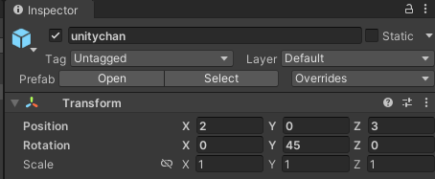
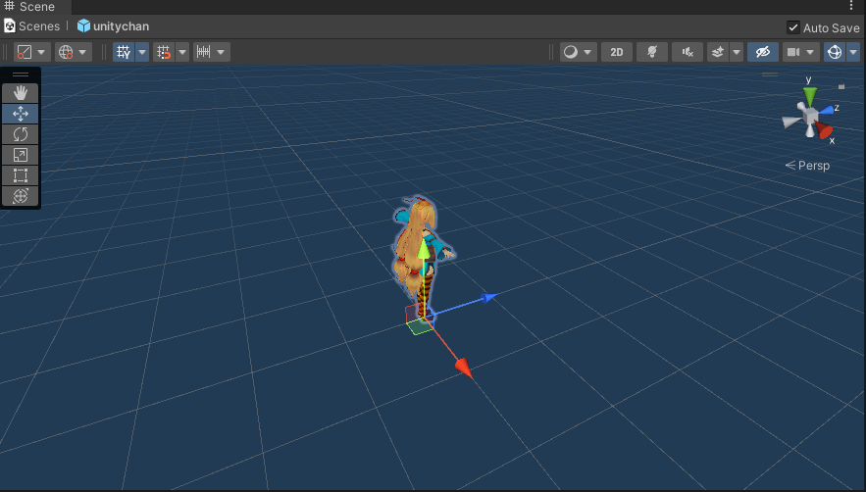
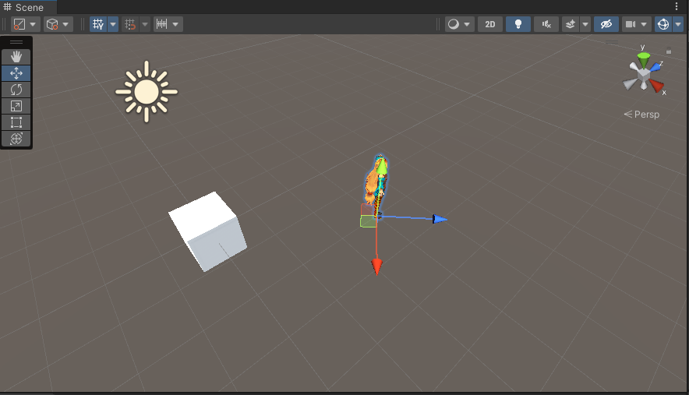
World matrix
$$W$$
$$W^{−1}$$

Slide 12
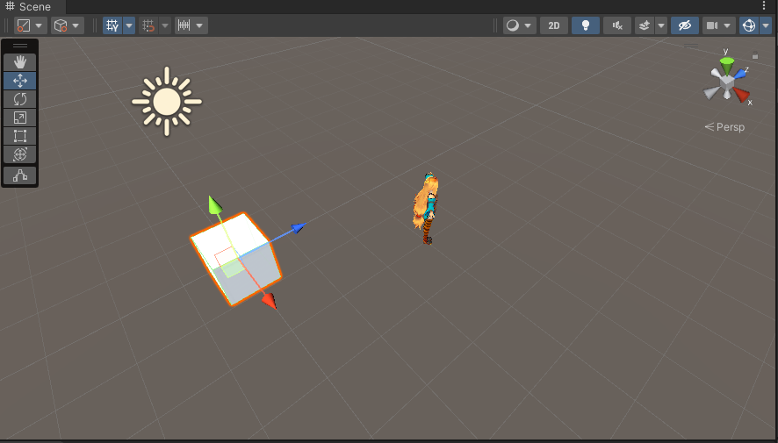
Scale
Rotation
Translation

Slide 13
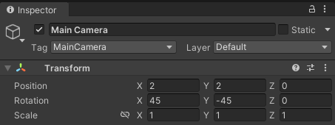
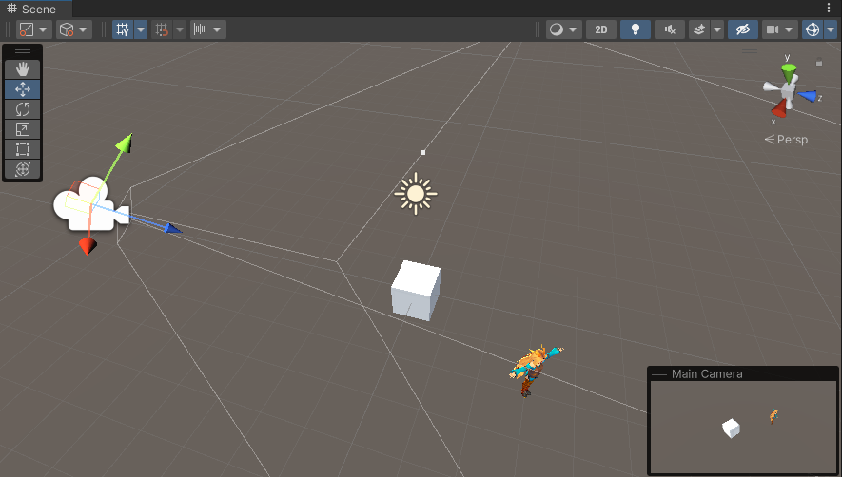

view matrix
$$V$$
$$V^{−1}$$

Slide 14
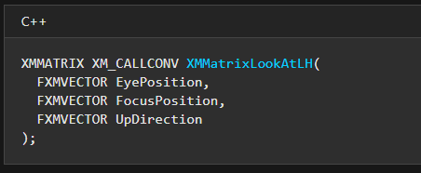
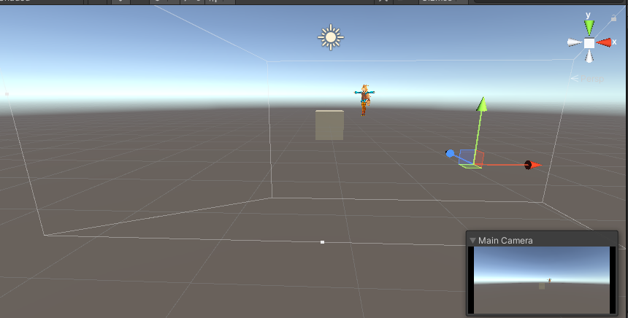
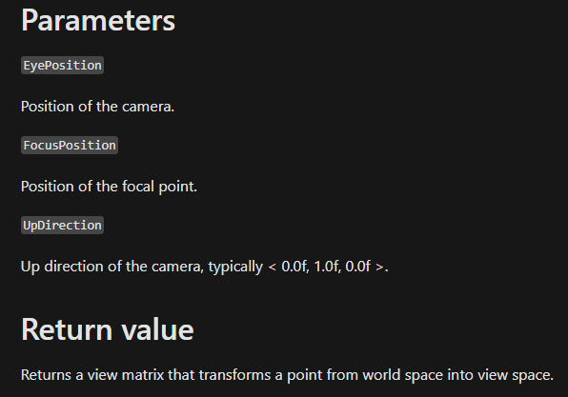

$$\left[\begin{matrix}{Right}_{x} & {Up}_{x} & {Look}_{x} & 0 \\ {Right}_{y} & {Up}_{y} & {Look}_{y} & 0 \\ {Right}_{z} & {Up}_{z} & {Look}_{z} & 0 \\ −\vec{C}⋅\vec{Right} & −\vec{C}⋅\vec{Up} & −\vec{C}⋅\vec{Look} & 1\end{matrix}\right]$$

Slide 15
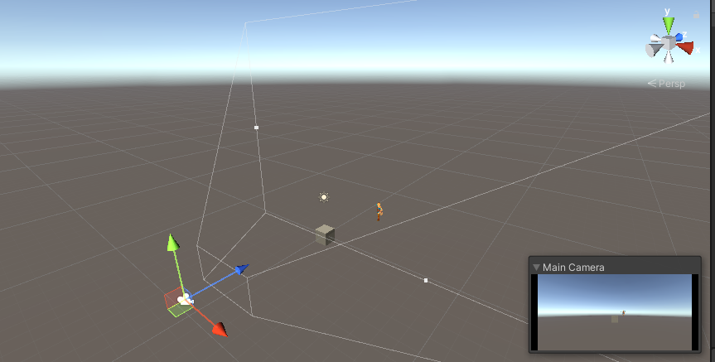
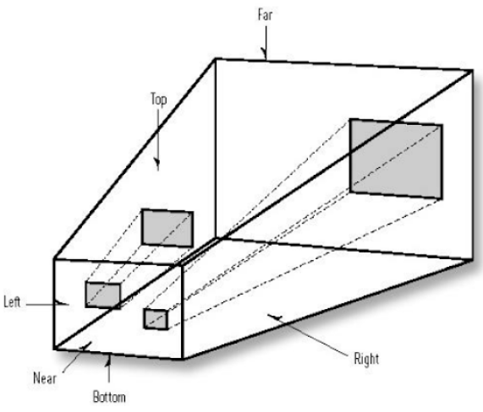
projection matrix
$$P$$
$$P^{−1}$$

Slide 16
$\vec{V}=$($\frac{x}{\text{r}tan⁡(\frac{α}{2}) }$, $\frac{y}{tan⁡(\frac{α}{2})}$, Az+$B$, z)
$\vec{V′}=$($\frac{x}{\text{r}\text{z}tan⁡(\frac{α}{2}) }$, $\frac{y}{\text{z}tan⁡(\frac{α}{2})}$, A+$\frac{B}{z}$, 1)
A+$\frac{B}{n}$ = 0
A+$\frac{B}{f}$ = 1
A = $\frac{f}{f−n}$
B = $\frac{−nf}{f−n}$
M = $\left[\begin{matrix}\frac{1}{\text{r}tan⁡(\frac{α}{2}) } & 0 & 0 & 0 \\ 0 & \frac{1}{tan⁡(\frac{α}{2})} & 0 & 0 \\ 0 & 0 & \frac{f}{f−n} & 1 \\ 0 & 0 & \frac{−nf}{f−n} & 0\end{matrix}\right]$
$$\vec{v}=\left[\begin{matrix}\begin{matrix}x & y & z\end{matrix} & 1\end{matrix}\right]$$

Slide 17
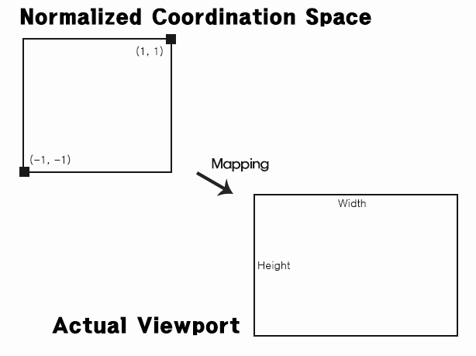
screen space (window space)

Slide 18





M = $\left[\begin{matrix}\frac{W}{2} & 0 & 0 & 0 \\ 0 & −\frac{H}{2} & 0 & 0 \\ 0 & 0 & MaxD−MinD & 0 \\ \frac{W}{2}+Left & \frac{H}{2}+Top & MinD & 1\end{matrix}\right]$
$$MaxDepth$$
$$MinDepth$$
$$0$$
$$1$$

Slide 19
Space transformation

Slide 20
Quiz1 : 지난번에 이런 거 안 했는데 왜 이미지가 떴을까?

Slide 21
Quiz2 : 컨텐츠 작업한다면 좌표는 어느 공간의 좌표일까?

Slide 22
Quiz3 : 화면 공간을 클릭하면 어느 공간의 좌표일까?

